Slide 1
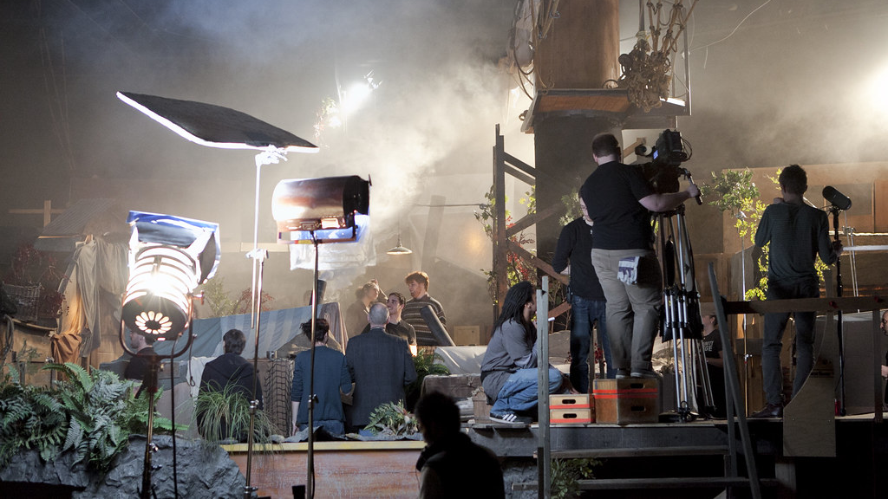
FILM CREW APP
Get collabs.
Get experience.
Get hired.
This Photo by Unknown author is licensed under CC BY.

Slide 2
About Me
Yeri F. Martinez
Microsoft Software & Systems Academy |Cohort SD6
Credentials
Master's Degree in Social Entrepreneurship from Fort Hays State University.
Bachelor's Degree in Film Studies from Rhode Island College.

Slide 3
The Application
A collaborative social media platform where creatives build networks, partnerships, and the experience needed to start their paying careers in the film and TV industries.

Slide 4


Slide 5
The Bad
Not all who aspire to get into film and TV industry are able to get a formal education.
Geographical limitations – There are key geographical areas where many of the jobs are concentrated – Los Angeles, New York, and Atlanta being the largest.
There simply aren't enough jobs to go around – Past experience, contacts, and persistence is key to gaining a paying gig.
There were about 5,750 Cinemas in the US as of 2017, decreasing steadily since the year 2000 and stood at 7,480 back in 1997.

Slide 6
The Good
Recognized film programs in academies and colleges provide students with a well-rounded education – qualifying them for a variety of roles in the film making process. (examples in the next slide)
A formal education is not a must to enter the field.
The global film industry shows healthy projections for the coming years. The global box office increased from about 38 billion U.S. dollars in 2016 to nearly 50 billion U.S. dollars in 2020. The U.S. is the third largest film industry in terms of tickets sold per year, ranking behind China and India. -Statista
With streaming gaining a strong hold in the TV market, more opportunities for home entertainments are increasing as movie theater prices increase.
The internet has made it possible for filmmakers can gain experience anywhere and even work from home.

Slide 7
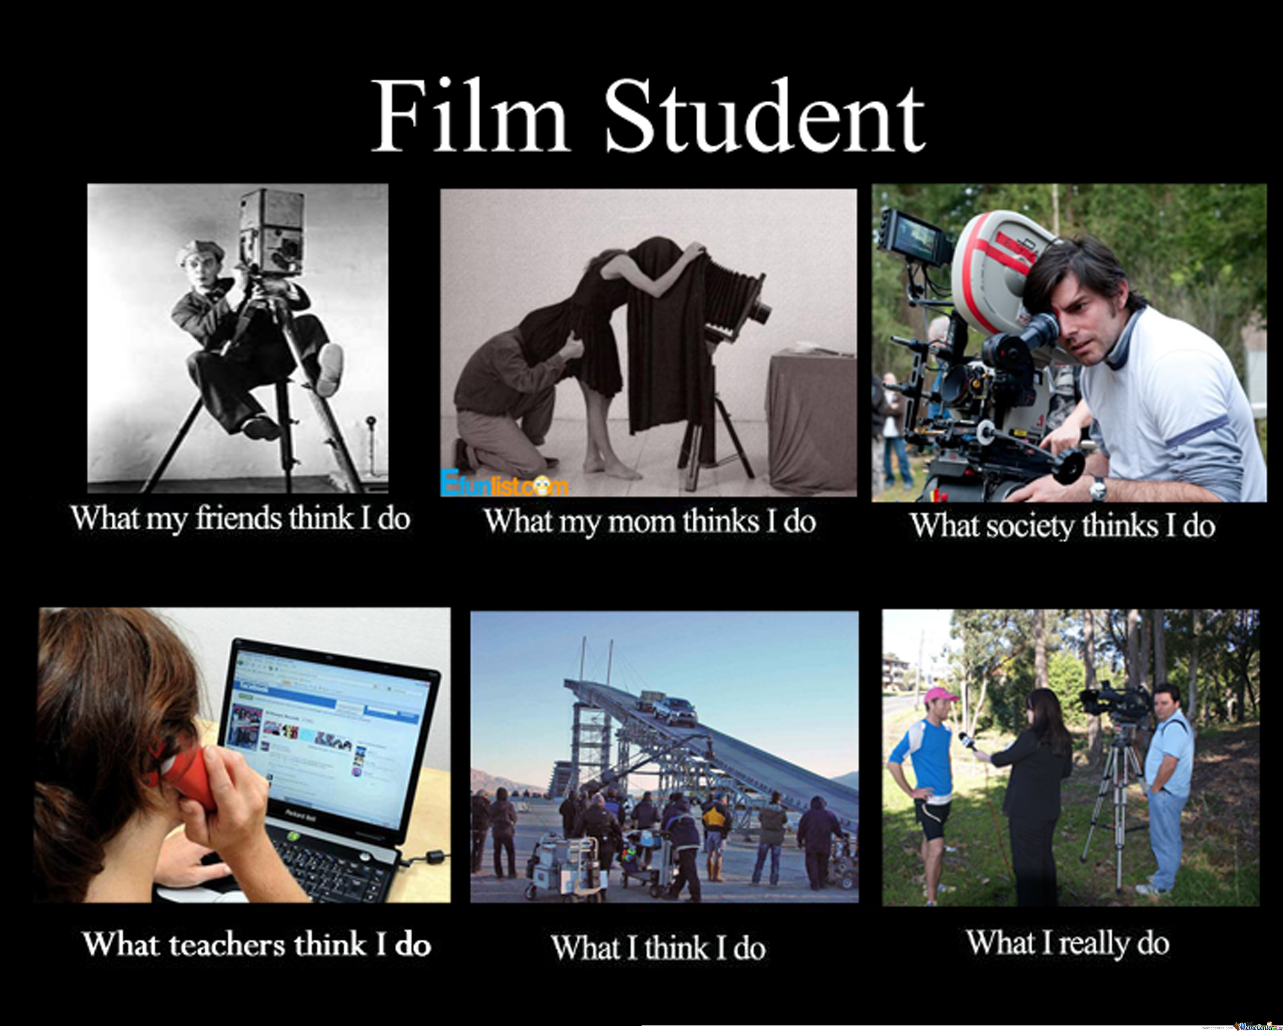
The Ugly

Slide 8
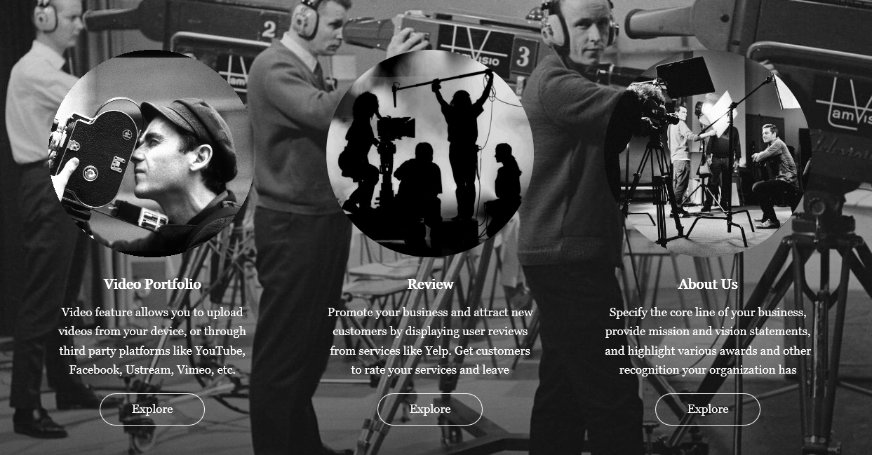

Slide 9
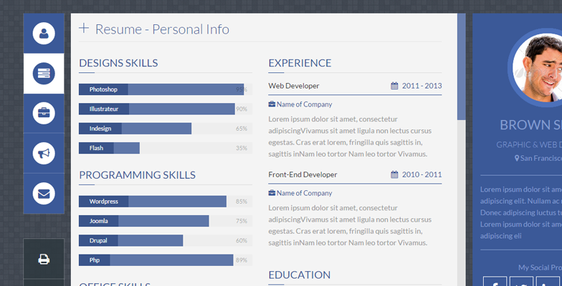

Slide 10
Film Skills and Careers
Director
Producer
Actor
Lighting
Camera Work
casting
stunts
costume designers
hair stylists
makeup artists
grips
gaffers
best boys
stand-ins

Slide 11
Skills Needed
Junior Mentorship Program
Portfolio
User
Goes to
Application
Identifying Information
M
1
Chat
Social Media
Skills Offered
Reviews

Slide 12
Thank you!

